Slide 1
EdgeAIGC based multi-model ML
CornerComputers
EC-
Manas Viswajith - CB.SC.U4CSE23337 Nandagopal Menon - CB.SC.U4CSE23340
Nanditha - CB.SC.U4CSE23339
Jai Subiksha - CB.SC.U4CSE23327
CI-
Ashwin Kumar - CB.SC.U4CSE23308
Aditya S - CB.SC.U4CSE23210

Slide 2


Corner Computers
Project phase:
Initial Implementation & Simulation

Slide 3
Issues Raised in Review 1
Company Name
Date
Application Standpoint
01
TD3 Implementation Concerns
02
Edge Deployment Concerns
03
Motivation for RL
04

Slide 4
Where we are
Company Name
Date
01
Finalizing the Models
02
Implementation Designing
03
Implementation

Slide 5
Models we are simulating
Congestion Prediction
Incident Detection
Traffic Volume Prediction
Vehicle Classification

Slide 6
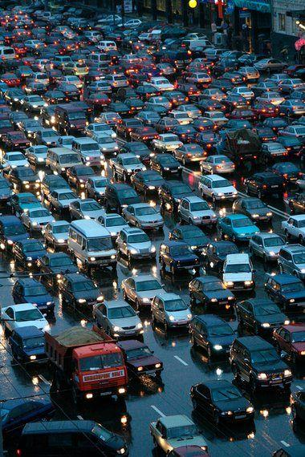
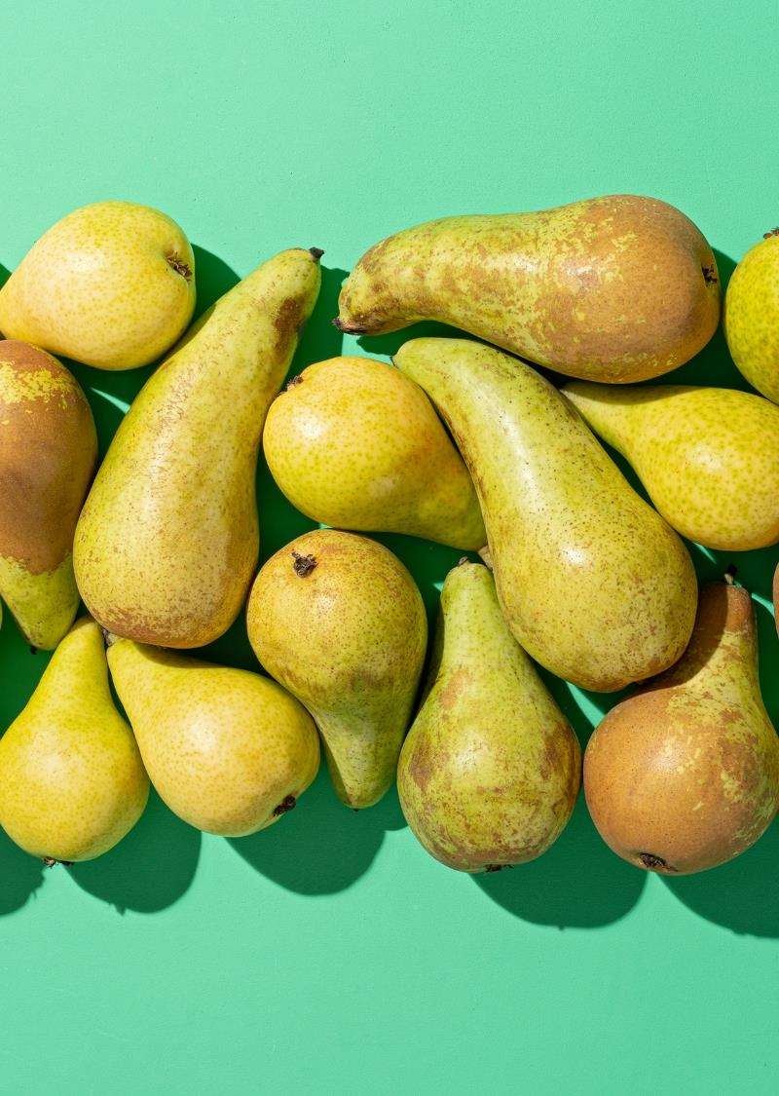
MODELS
Traffic volume prediction at junction estimation using sensor data collected at the specific junction.
Traffic congestion estimation using various data such as Temperature, Rain, Snow, Weather Descriptions.

Slide 7
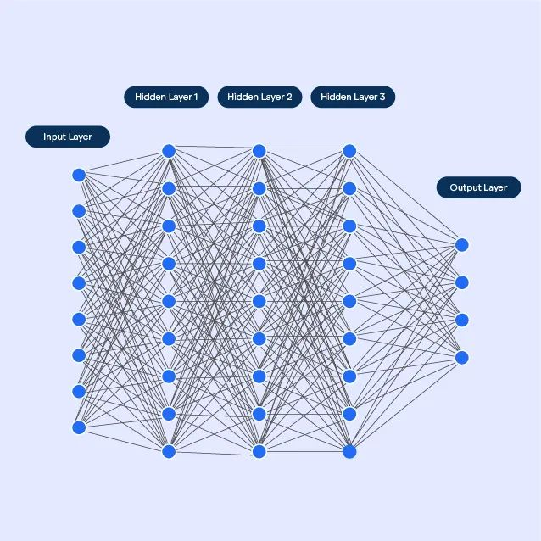
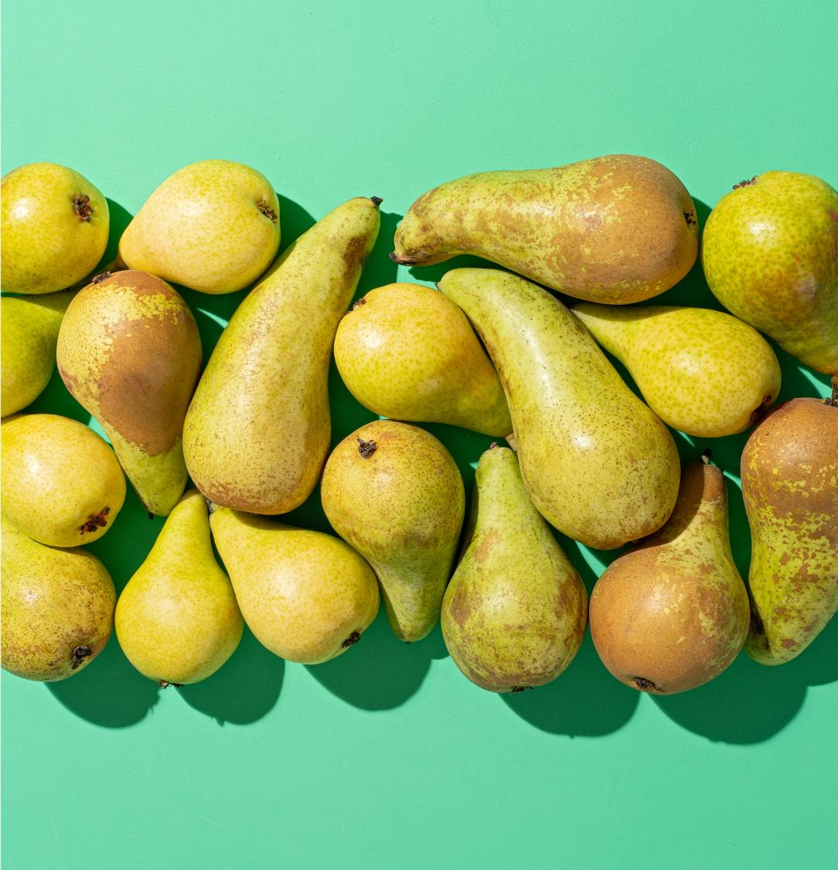
Introduction
We have used CNN (Convolutional Neural Networks) to build both the models. 1D convolutions have been used in the data.
Datasets for training of both the models have been taken from kaggle.
Basic python packages have been used for training the model as usual, such as tensorflow, pandas, numpy, etc,.

Slide 8
TRAFFIC CONGESTION ESTIMATION USING WEATHER DATA
MODEL 1

Slide 9
About the Model & Dataset
Dataset
Data set is a CSV file with columns such as holiday, temp, rain, snow, clouds, weather, datetime, and traffic volume.
Training
1-D convolutions has been used to train the model.
60% of the data to train, 20% data to validate and 20% data to set the model.
Necessary Preprocessing: filling out the missing values, feature extraction, reshaping of the sample and features to the appropriate dimensions.
Specification
Input shape is in tuple as (n_features, 1)
3 convolutional layers with increasing filters, 4 dense layers with decreasing neurons, and batch normalization.

Slide 10
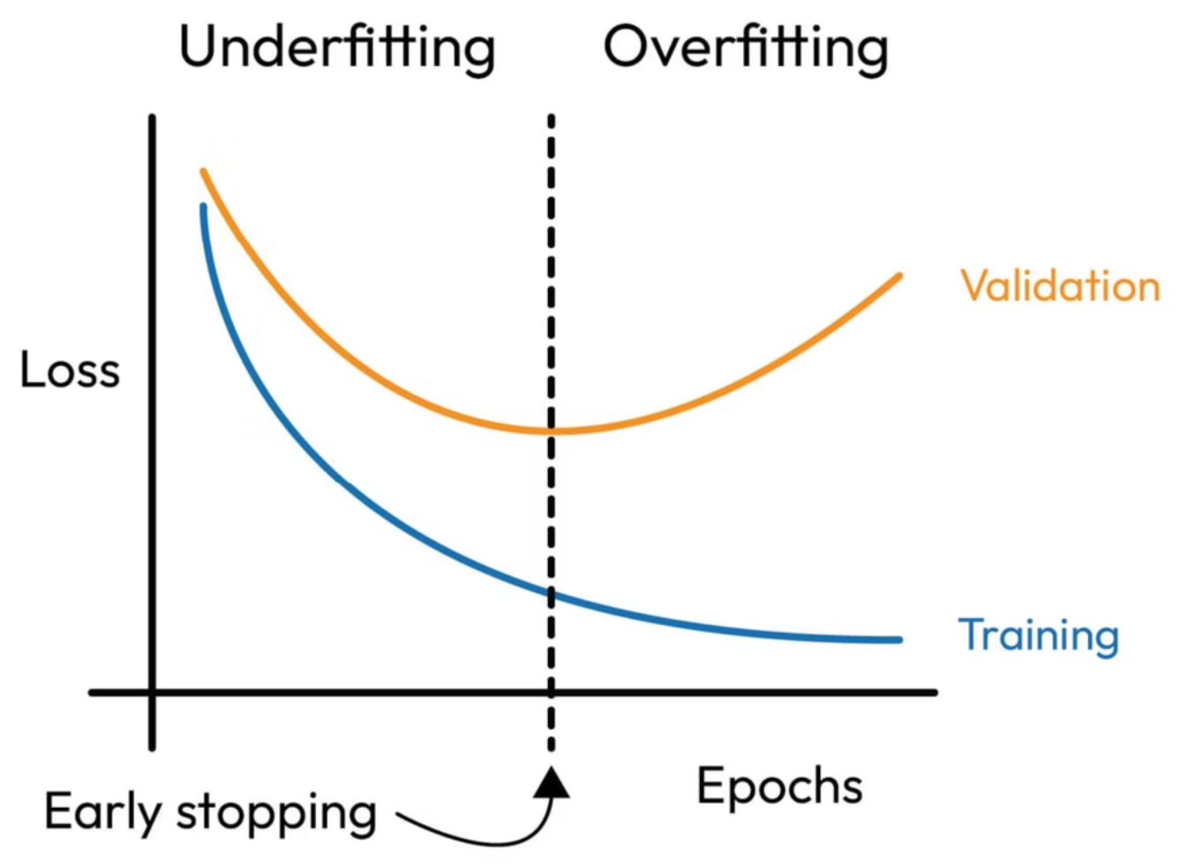
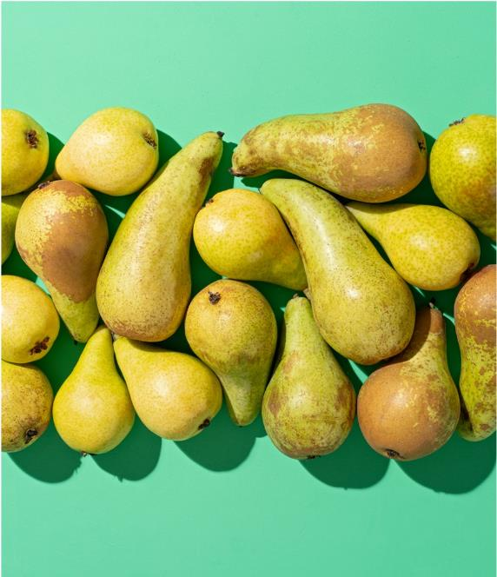
Configuration & Optimization
Training Configuration
Loss Function – Mean Squared Error
Metrics – Mean Absolute Error
Batch Size – 32
Epochs - 100
Regularization
Dropout - applied at Each Layers
Batch normalization – After each Conv1D layer
Early Stoppage – to prevent overfitting of the model

Slide 11
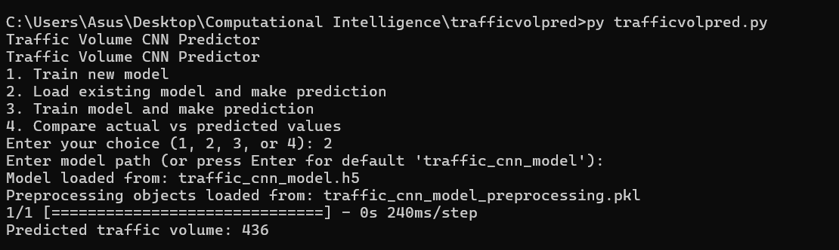
Model Test Output When Fed with Sample Test Data

Slide 12
TRAFFIC VOLUME PREDICTION AT SPECIFIC JUNCTION
MODEL 2

Slide 13
About Model & Dataset
Dataset
Data set is a CSV file with columns datetime, junction, vehicles & ID.
Training
1-D Convolutional network
64-16-20 split of the dataset for training, validation and test.
3 conv layer and 3 dense layer. .
Specification
5 way input features which are vehicles, hour, day of the week, month and junction.
Input shape is as tuple (n_samples, 24, 5), input to model per batch is (32, 24, 5).

Slide 14
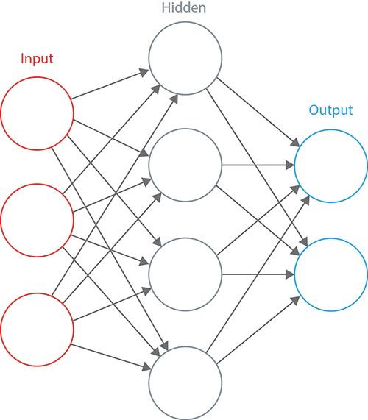
Configuration & Optimization
Training Configuration
Loss Function – Mean Squared Error
Metrics – Mean Absolute Error
Batch Size – 32
Epochs - 100
Learning Rate - 0.001
For Data Scaling MinMax Scaler has been used.
R^2 score calculated for evaluation metrics.

Slide 15
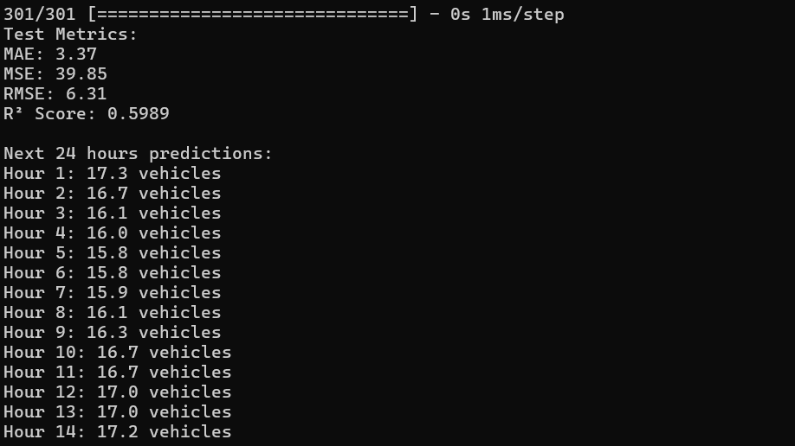
Model's Prediction of Traffic Vol. with Sample Test Data

Slide 16
CONCLUSION
Two Models have been implemented, few more model's is planned to accommodate to the requirements received from Edge team.
Incident Detection Using Camera Feeds
Vehicle Classification and Traffic Flow
These two ideas have been set for further future implementation.

Slide 17
Initial Architecture Diagram

Slide 18
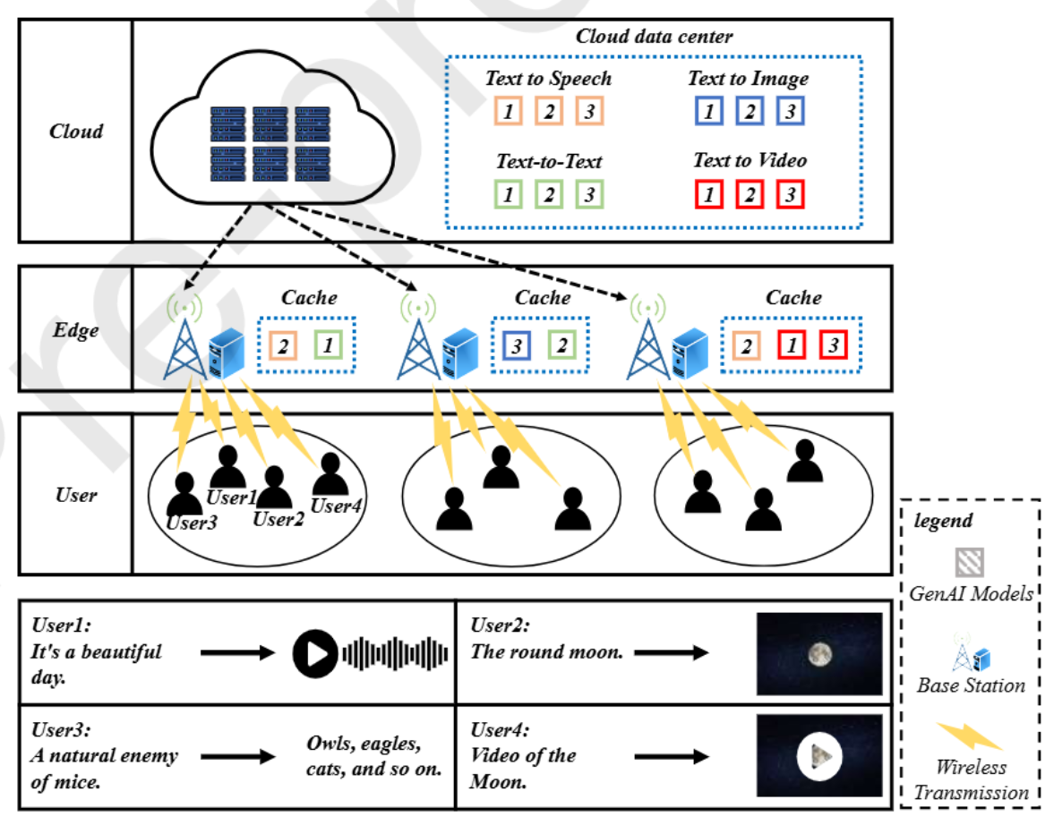

Slide 19
Updated Architecture Diagram

Slide 20
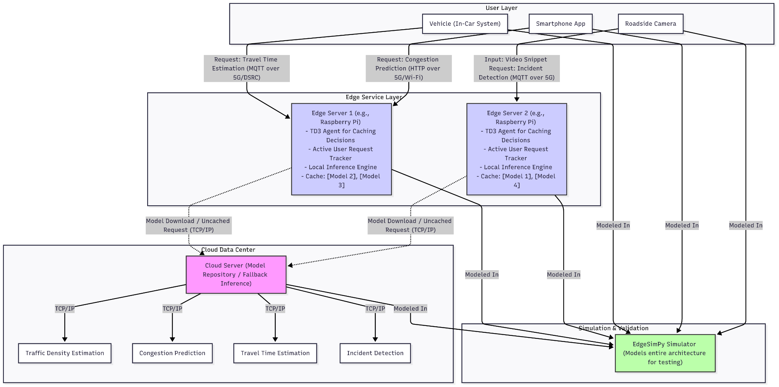

Slide 21
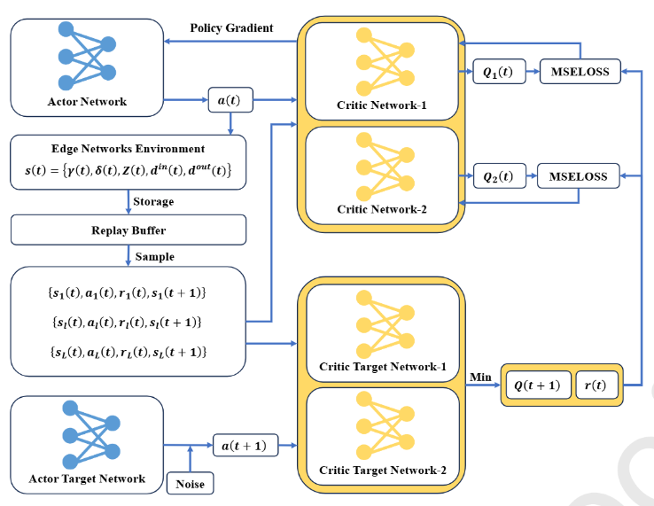
TD3
Algorithm

Slide 22
# Dummy Environment
class DummyEnv:
def __init__(self):
self.state_dim = 3 # number of state features
self.action_dim = 1 # one action output
self.max_steps = 10
self.reset()
def reset(self):
self.state = np.random.randn(self.state_dim)
self.steps = 0
return self.state
def step(self, action):
self.steps += 1
reward = random.uniform(0, 20) # random reward
next_state = np.random.randn(self.state_dim)
done = self.steps >= self.max_steps
return next_state, reward, done
CODE WALKTHROUGH
# Replay Buffer
class ReplayBuffer:
def __init__(self, max_size=1000):
self.buffer = deque(maxlen=max_size)
def add(self, transition):
self.buffer.append(transition)
def sample(self, batch_size):
return random.sample(self.buffer, batch_size)
def size(self):
return len(self.buffer)

Slide 23
# Actor Network
class Actor(nn.Module):
def __init__(self, state_dim, action_dim):
super(Actor, self).__init__()
self.layer1 = nn.Linear(state_dim, 128)
self.layer2 = nn.Linear(128, 128)
self.output = nn.Linear(128, action_dim)
def forward(self, state):
x = torch.relu(self.layer1(state))
x = torch.relu(self.layer2(x))
return torch.tanh(self.output(x))
# Critic Network
class Critic(nn.Module):
def __init__(self, state_dim, action_dim):
super(Critic, self).__init__()
self.layer1 = nn.Linear(state_dim + action_dim, 128)
self.layer2 = nn.Linear(128, 128)
self.output = nn.Linear(128, 1)
def forward(self, state, action):
x = torch.relu(self.layer1(torch.cat([state, action], 1)))
x = torch.relu(self.layer2(x))
return self.output(x)

Slide 24
class TD3Agent:
def __init__(self, state_dim, action_dim, buffer_max=10000):
self.actor = Actor(state_dim, action_dim)
self.actor_target = Actor(state_dim, action_dim)
self.critic1 = Critic(state_dim, action_dim)
self.critic2 = Critic(state_dim, action_dim)
self.critic1_target = Critic(state_dim, action_dim)
self.critic2_target = Critic(state_dim, action_dim)
# Copy params to target networks
self.actor_target.load_state_dict(self.actor.state_dict())
self.critic1_target.load_state_dict(self.critic1.state_dict())
self.critic2_target.load_state_dict(self.critic2.state_dict())
self.buffer = ReplayBuffer(buffer_max)
self.actor_optimizer = optim.Adam(self.actor.parameters(), lr=1e-3)
self.critic1_optimizer = optim.Adam(self.critic1.parameters(), lr=1e-3)
self.critic2_optimizer = optim.Adam(self.critic2.parameters(), lr=1e-3)
self.gamma = 0.99
self.tau = 0.005
def update(self, batch_size=32):
if self.buffer.size() < batch_size:
return
batch = self.buffer.sample(batch_size)
states, actions, rewards, next_states, dones = zip(*batch)
states = torch.FloatTensor(states)
actions = torch.FloatTensor(actions)
rewards = torch.FloatTensor(rewards).unsqueeze(1)
next_states = torch.FloatTensor(next_states)
dones = torch.FloatTensor(dones).unsqueeze(1)
with torch.no_grad():
noise = (torch.randn_like(actions) * 0.2).clamp(-0.5, 0.5)
next_action = (self.actor_target(next_states) + noise).clamp(-1, 1)
q1_target = self.critic1_target(next_states, next_action)
q2_target = self.critic2_target(next_states, next_action)
q_target = rewards + self.gamma * (1 - dones) * torch.min(q1_target, q2_target)

Slide 25
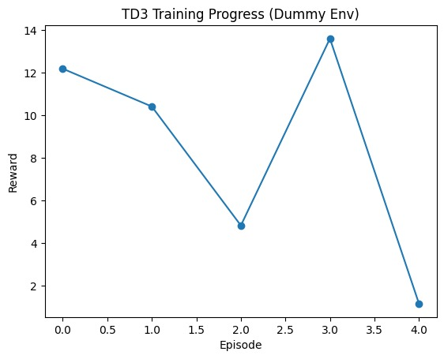
Output
-Validates TD3 pipeline
(state → action → replay → training → output)
-Confirms code runs correctly before real environment

Slide 26
User Request Handling
Purpose
Bridge between user devices and the EdgeAIGC framework
Validate and route every traffic-related request (images, sensor feeds, live stats) with minimal delay
Flow
Request Arrival – Mobile app or roadside sensor sends a request for M1: Traffic Density Estimation or M2: Congestion Prediction model.
Edge Validation – Parse payload, check format and authentication
Cache Check – Edge server looks for the required model in its local cache and runs inference if found
Cloud Fallback – On a cache miss, forward to the cloud and return the result
TD3 Feedback Loop – TD3 agent observes latency, popularity, and network state, then updates caching and resource-allocation decisions in real time

Slide 27
STATE_DIM = 4
ACTION_DIM = 2
MAX_ACTION = 1.0
CACHE_LIMIT = 20 # MB
BANDWIDTH = 10 # MB per time unit
RUNS = 1000
USERS = 4
# Cloud catalogue: model name -> size (MB)
MODEL_CATALOG = {
"Traffic-Junction-CNN": 1.2,
"Traffic-Volume-CNN": 11.2,
"Incident-Detection-CNN": 15.3,
"Vehicle-Classification-CNN": 5.6
Code Walkthrough
# Each user’s probability distribution over models
USER_BIAS = [
{"Traffic-Junction-CNN":0.6, "Traffic-Volume-CNN":0.25,
"Incident-Detection-CNN":0.1, "Vehicle-Classification-CNN":0.05},
{"Traffic-Junction-CNN":0.1, "Traffic-Volume-CNN":0.65,
"Incident-Detection-CNN":0.2, "Vehicle-Classification-CNN":0.05},
{"Traffic-Junction-CNN":0.15,"Traffic-Volume-CNN":0.2,
"Incident-Detection-CNN":0.55,"Vehicle-Classification-CNN":0.1},
{"Traffic-Junction-CNN":0.05,"Traffic-Volume-CNN":0.15,
"Incident-Detection-CNN":0.2, "Vehicle-Classification-CNN":0.6},
]

Slide 28
def run_user_requests(cache):
"""Generate biased user requests and update cache + metrics."""
td3 = TD3(STATE_DIM, ACTION_DIM, MAX_ACTION)
buff = ReplayBuffer()
data_fetched = []
# RL training step
next_state = np.random.randn(STATE_DIM)
reward = -np.mean(wait_times[-USERS:]) # negative latency as reward
buff.add((state, next_state, action, reward, 0))
if len(buff.storage) > 32:
td3.train(buff, batch_size=32)
return {
"avg_wait_time": sum(wait_times)/len(wait_times),
"avg_data_MB": sum(data_fetched)/len(data_fetched),
"cache_hit_rate": cache.get_cache_hit_rate()
}

Slide 29
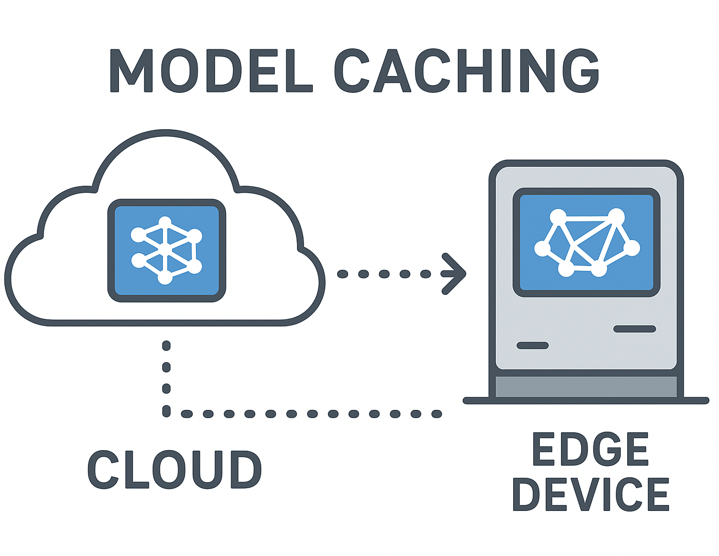
Model Caching

Slide 30
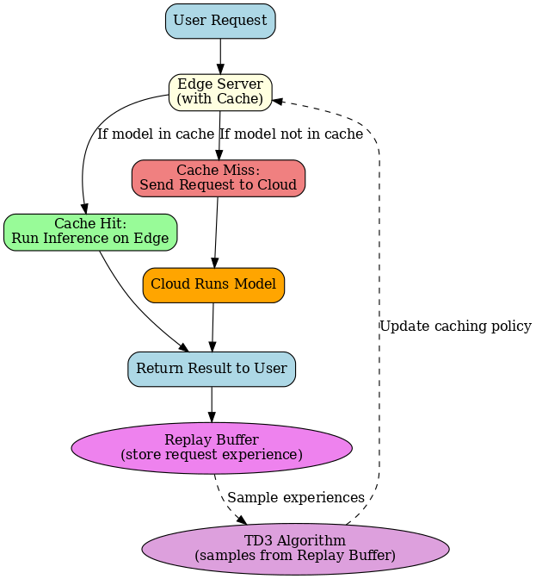
How it works:

Slide 31
Code Walkthrough
def is_cached(self, model_id):
if model_id in self.cache:
self.hits += 1
return True # cache hit
else:
self.misses += 1
return False #miss
def add_model(self, model_id, model_size):
while self.current_storage + model_size > self.storage_limit:
self.evict_model() # free space
self.cache[model_id] = {"size": model_size, "last_access": 0}
self.current_storage += model_size

Slide 32
def evict_model(self):
lru_model = min(self.cache, key=lambda m: self.cache[m]["last_access"])
self.current_storage -= self.cache[lru_model]["size"]
del self.cache[lru_model]
return lru_model

Slide 33
def handle_request(user_id, model_id, cache):
if cache.is_cached(model_id):
cache.update_cache_policy(model_id)
return {"status": "hit"}
else:
return {"status": "miss"} # fetch from cloud
def fetch_from_cloud(model_id, cache, model_size=1):
cache.add_model(model_id, model_size) # copy to cache
return {"model_id": model_id, "source": "cloud"}

Slide 34
Simulation and Test results
Notes:
Avg data sent by edge and avg w

Slide 35
Test results
Company Name
Date
Average Wait time per edge
Average data sent per edge
Average data received per edge
Model ran on Cloud - Requests and data sent from edge
45.45 time units
201.23 MB
Negligible
Model ran on edge per request
3.84 time units
Negligible
8.34 MB
Model ran on edge using TD3 and caching
3.39 time units
Negligible
3.92 MB

Slide 36
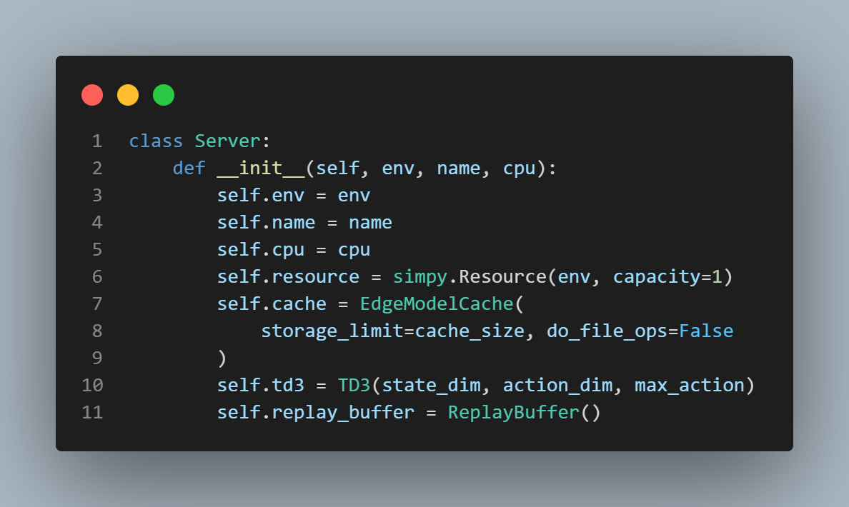

Slide 37
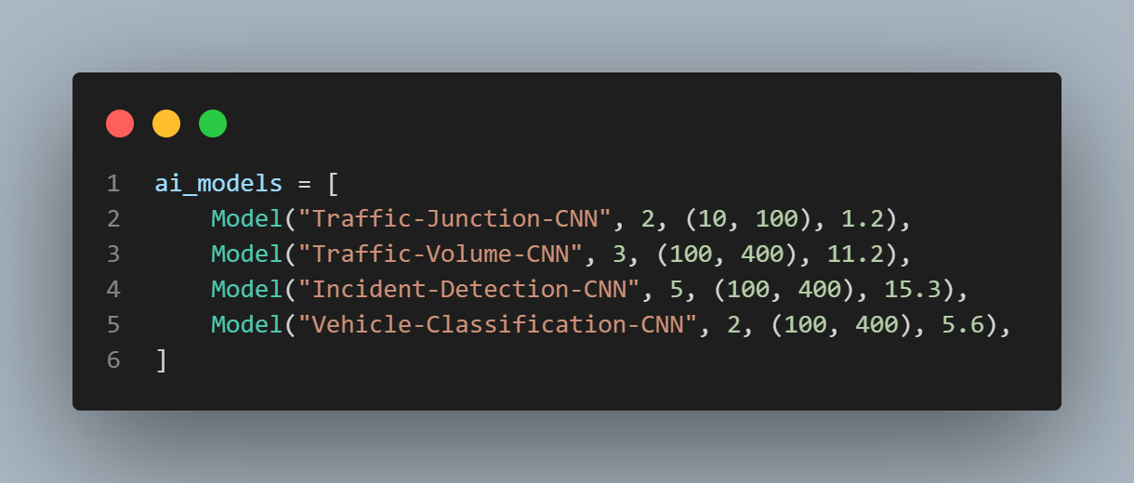

Slide 38
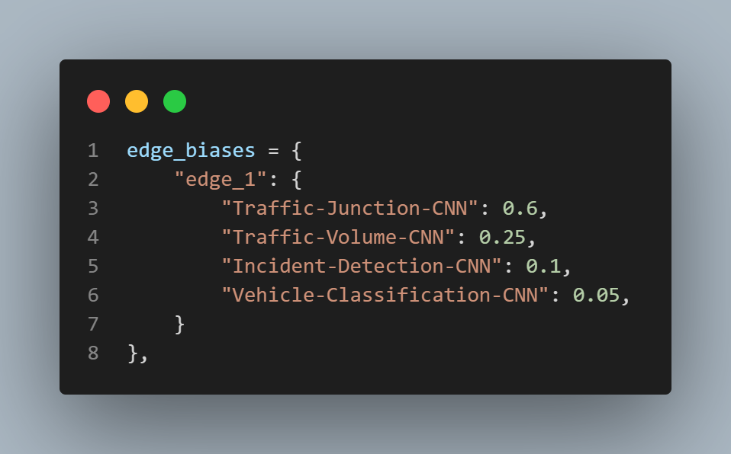

Slide 39
91.5 %
11.5 %
Better time than just cloud
Better time than without TD3 algorithm

Slide 40
95.9 %
53 %
More efficient than just cloud
More efficient than without TD3 algorithm

